Slide 1
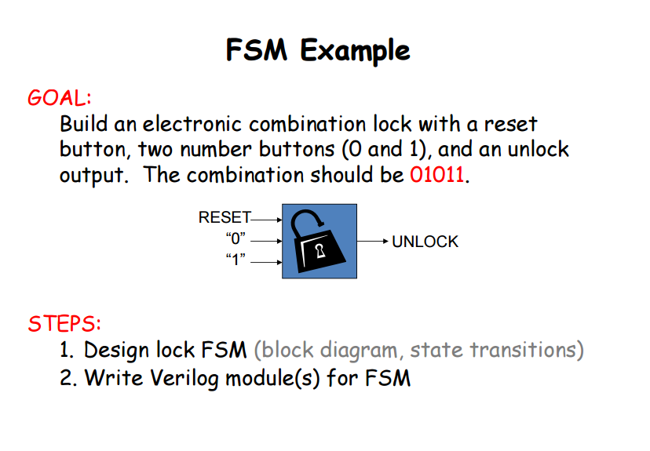
Exercise 5 – finite state machine

Slide 2
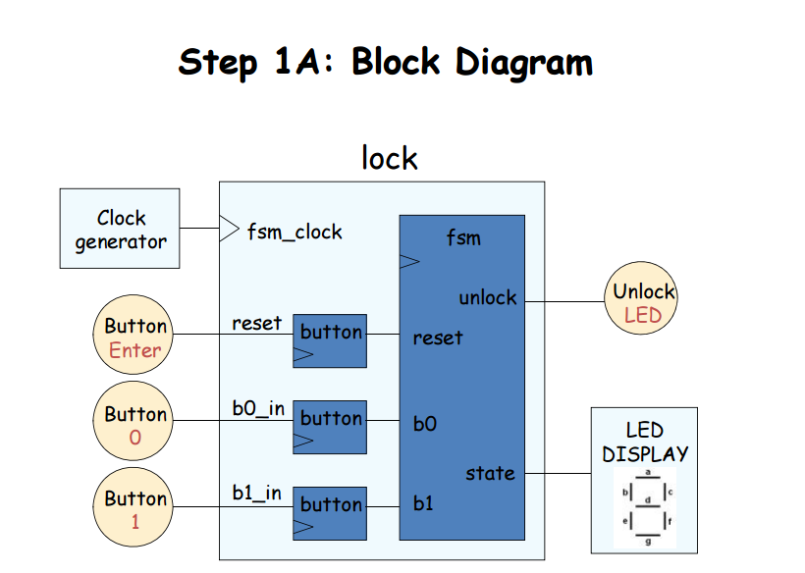

Slide 3
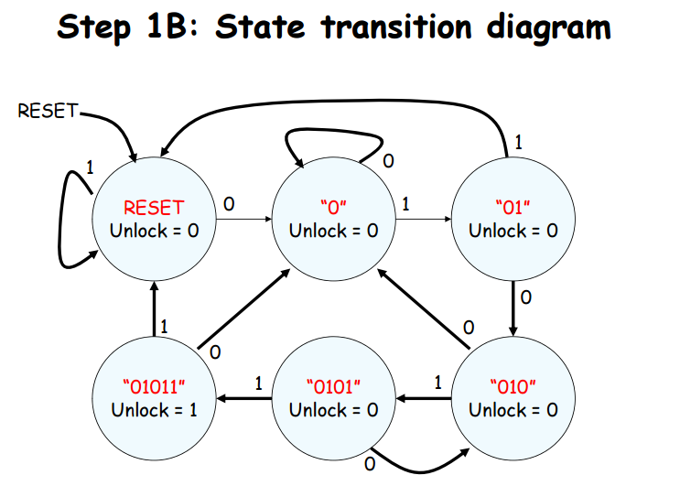

Slide 4
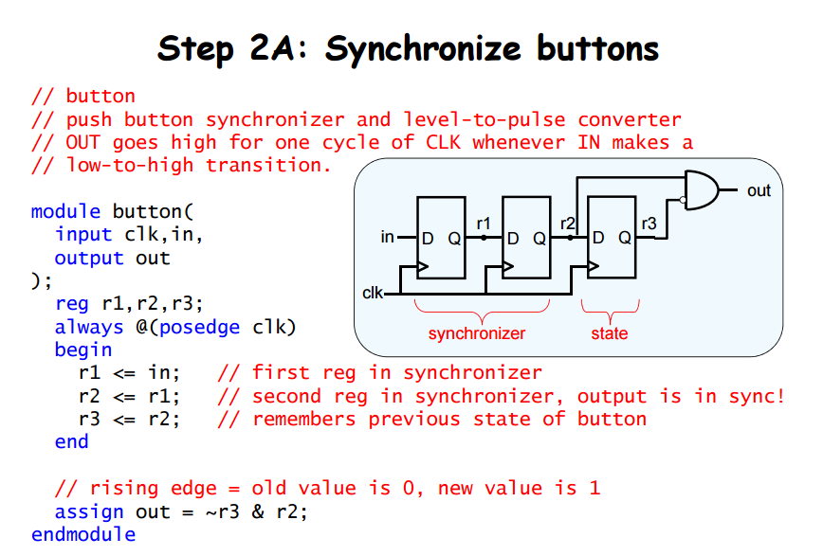

Slide 5
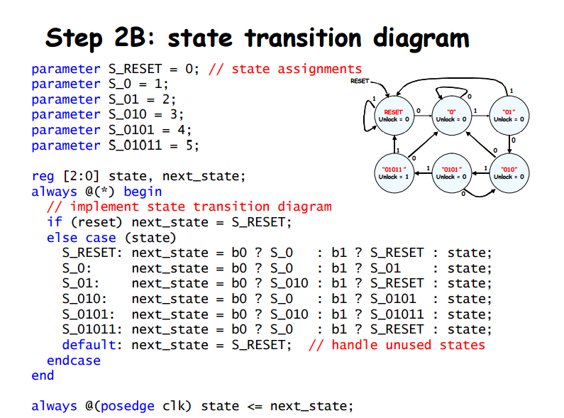

Slide 6
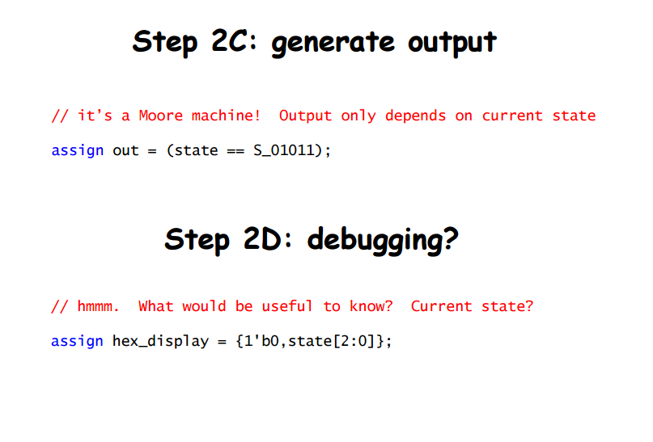

Slide 7
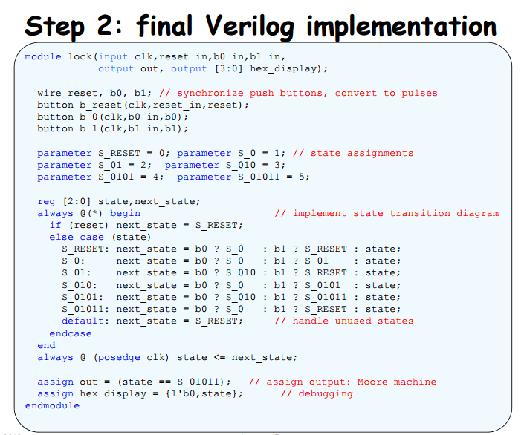

Slide 8
Design a Finite State Machine for an Garage Door Opener.
Read requirements, draw the State Diagram.
Define the FSM states as strings.
Create a Test bench and verify correct operation.
Present states as ASCII strings in the waveforms.
Files: Garage_Door.v ; Garage_Door_sim_wave.jpg

Slide 9
The Garage Door Opener, engaged in operation whenever it’s activated by a push-button. It uses the up and down limit sensors to stop the engine and set the next state.
* Note: activate cannot stop garage door during movement
Files: DoorOpener.v ; DoorOpenr_sim_wave.jpg
up_limit
motor_up
dn_limit
Garage Door
Opener
activate
motor_dn
clk
nrst

Slide 10
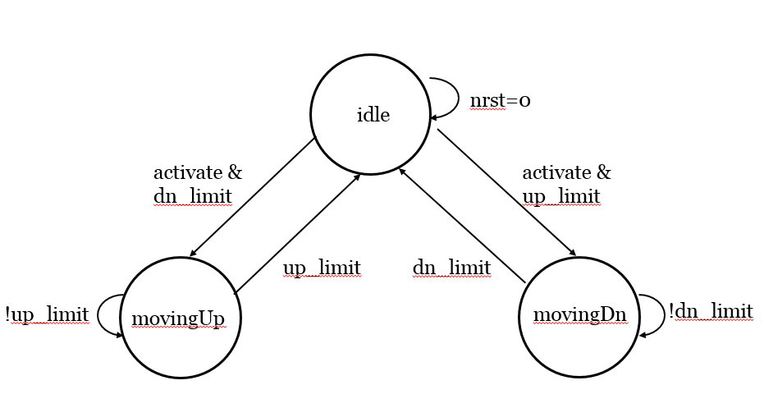
State diagram

Slide 11
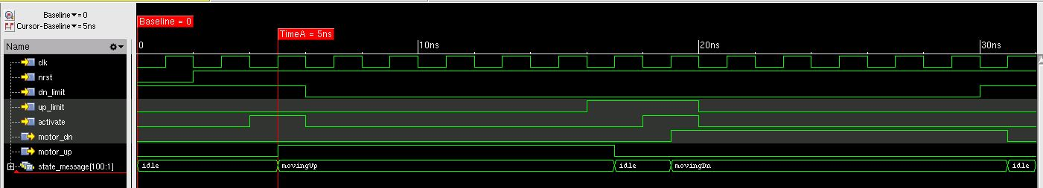
Simulation waveform

